Slide 1
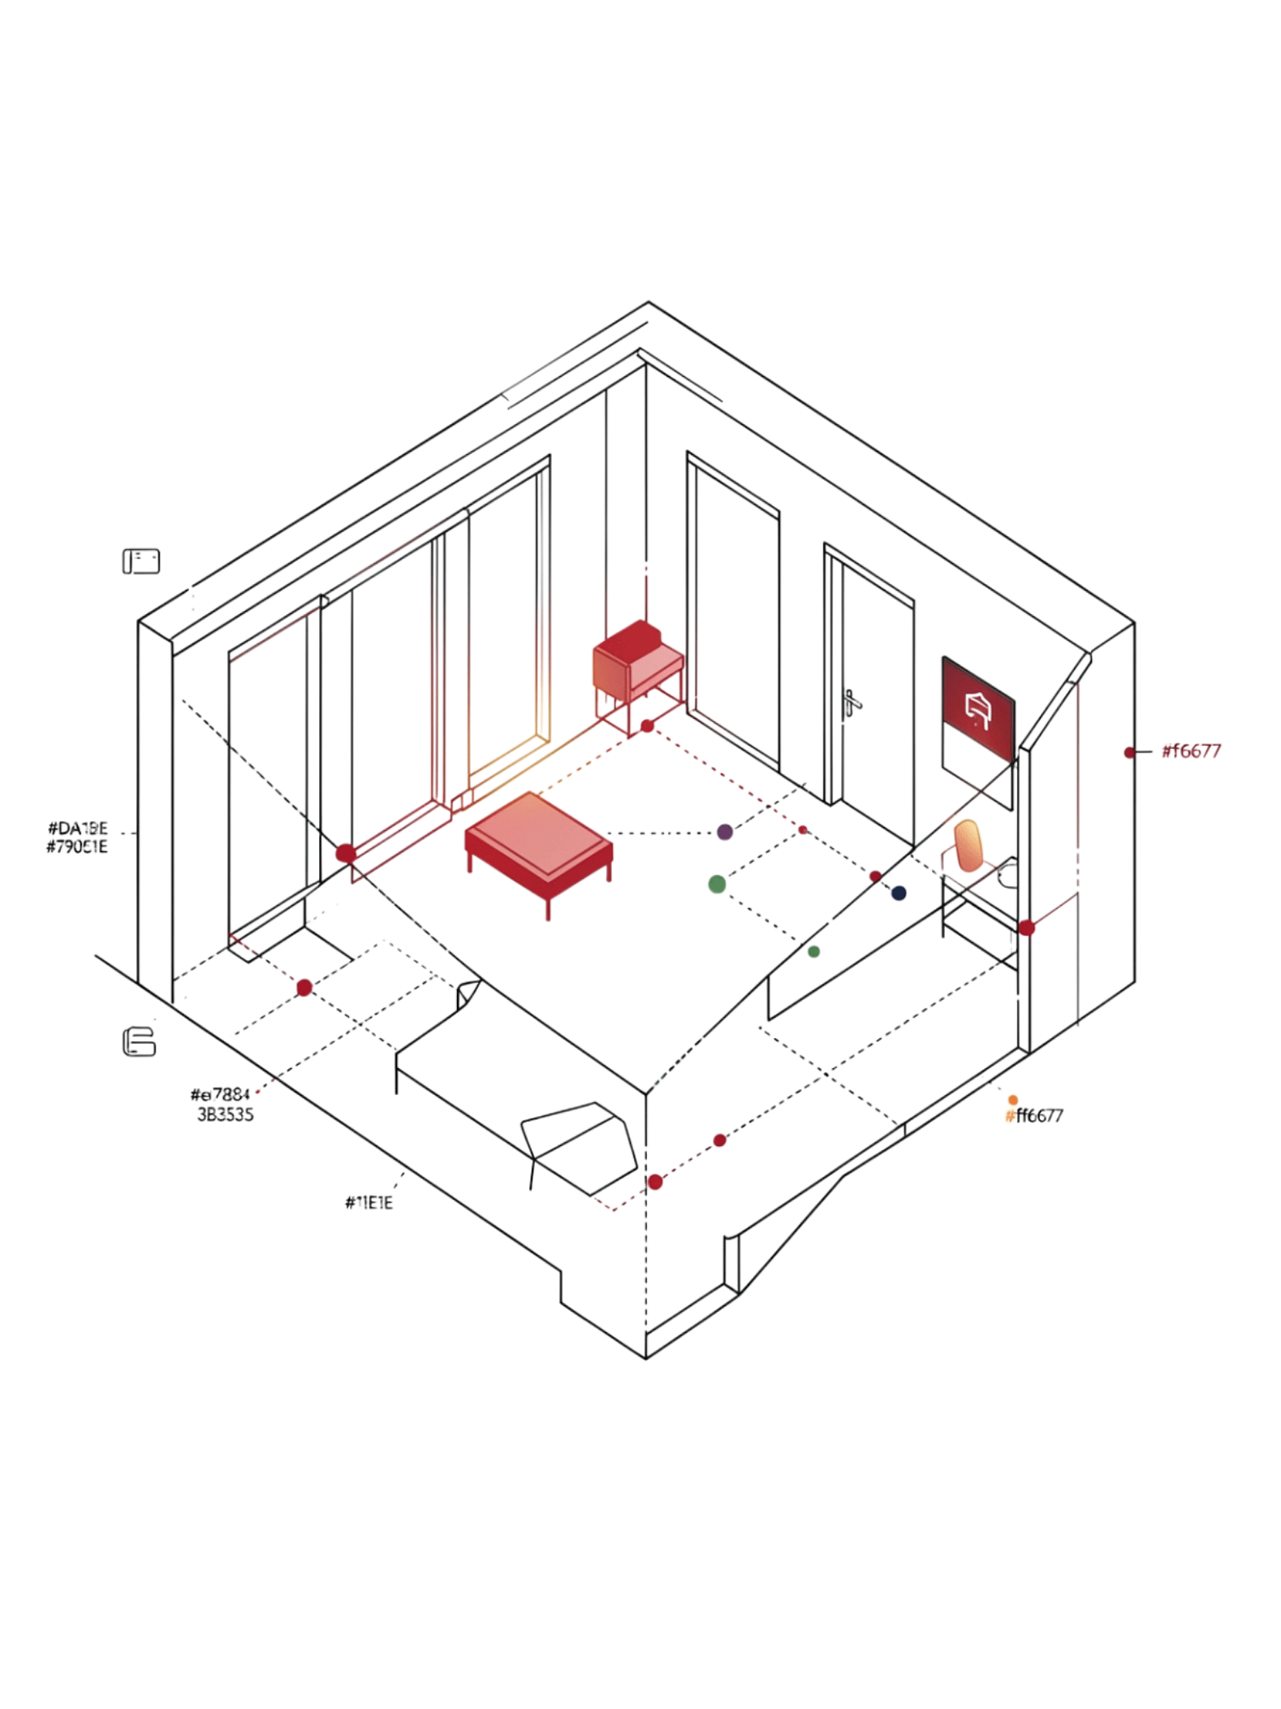
Smart Home Lighting Automation System Using Occupancy Detection and Intelligent Energy Management
An IoT-based academic project for intelligent, energy-efficient residential lighting control.
KOMARA PAVAN SAI
323129520007

Slide 2
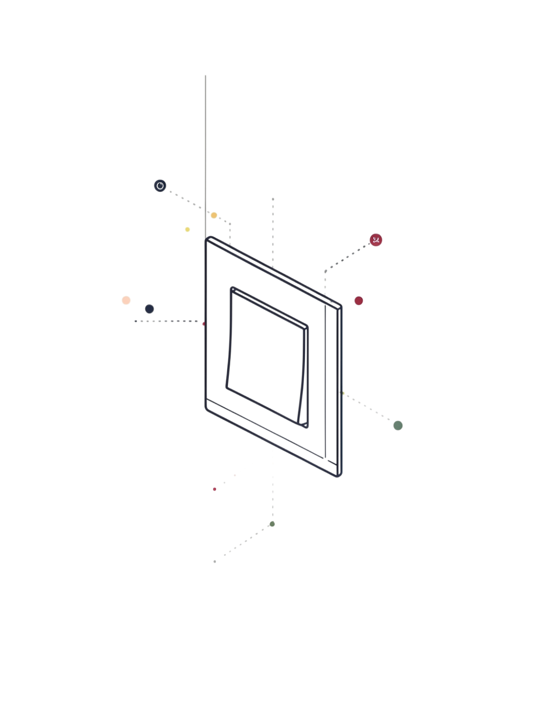
Problem Statement
Manual Operation
Traditional lighting systems require manual operation, placing the burden of control entirely on the homeowner.
Unoccupied Rooms
Lights frequently remain switched on when rooms are unoccupied, leading to avoidable energy waste.
Energy Wastage
Manual control results in unnecessary electricity consumption and higher utility costs over time.
Need for Intelligence
Homeowners need an intelligent system that automatically controls lighting according to room occupancy while optimizing energy usage.

Slide 3
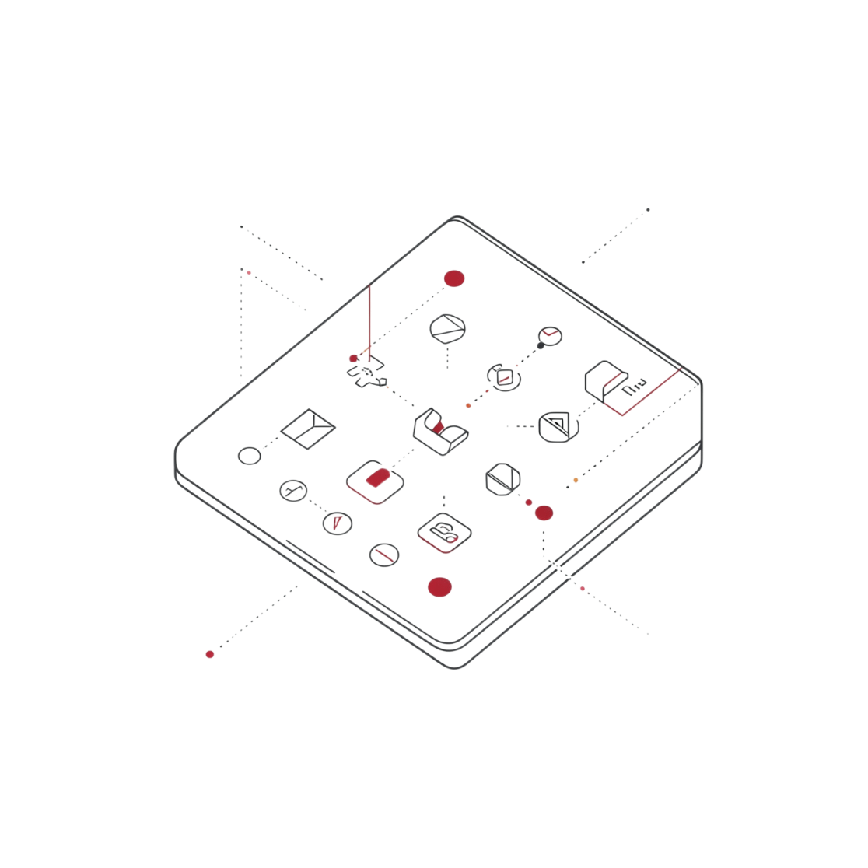
Proposed Solution
Intelligent Lighting Automation via IoT
The proposed system automatically controls home lighting using occupancy detection and IoT technologies, eliminating the need for manual intervention.
Detect whether a room is occupied or vacant in real time
Automatically switch lights ON when users are present
Automatically switch lights OFF when rooms become unoccupied
Provide centralized monitoring and control through a secure, user-friendly interface

Slide 4

System Architecture and Working
Detect Occupancy
Process IoT Data
Wireless Link
Control Lighting
IoT-based occupancy and motion sensors detect user presence and relay data through wireless communication to the automation controller. Lighting devices respond automatically to occupancy conditions, while energy consumption is monitored in real time and surfaced through a web or mobile dashboard.

Slide 5
Key Technologies
Internet of Things (IoT)
Occupancy & Motion Sensors
Wireless Communication
The foundational technology connecting sensors, controllers, and lighting devices into a unified automation network.
Detect human presence in each room to trigger automatic lighting responses in real time.
Connects all system components — sensors, controllers, and smart lighting devices — without physical wiring constraints.
Smart Lighting Devices
Energy Monitoring & Dashboard
Responsive lighting units that execute ON/OFF commands and support scheduling and remote control.
Real-time consumption tracking and a web or mobile dashboard for visualization, analytics, and remote control.
These technologies work together to create an intelligent lighting automation environment.

Slide 6
Major System Features
Automatic ON/OFF Control
Real-Time Occupancy Detection
Remote Lighting Control
Device Activity Monitoring
Lights respond instantly to occupancy without user input.
Control any light from anywhere via the web or mobile interface.
Log and review the activity history of all connected devices.
Continuous sensor monitoring of each room's occupancy state.
Usage Analytics & Reports
Centralized Management
Room-Wise Status Monitoring
Energy Consumption Monitoring
Detailed energy reports and usage analytics for informed decisions.
All rooms and devices managed from a single unified platform.
Individual room lighting status visible at a glance.
Track electricity usage per device and per room in real time.
Secure & User-Friendly
Lighting Schedules
Designed for ease of use with robust access security.
Pre-configure lighting timers for routine automation.

Slide 7
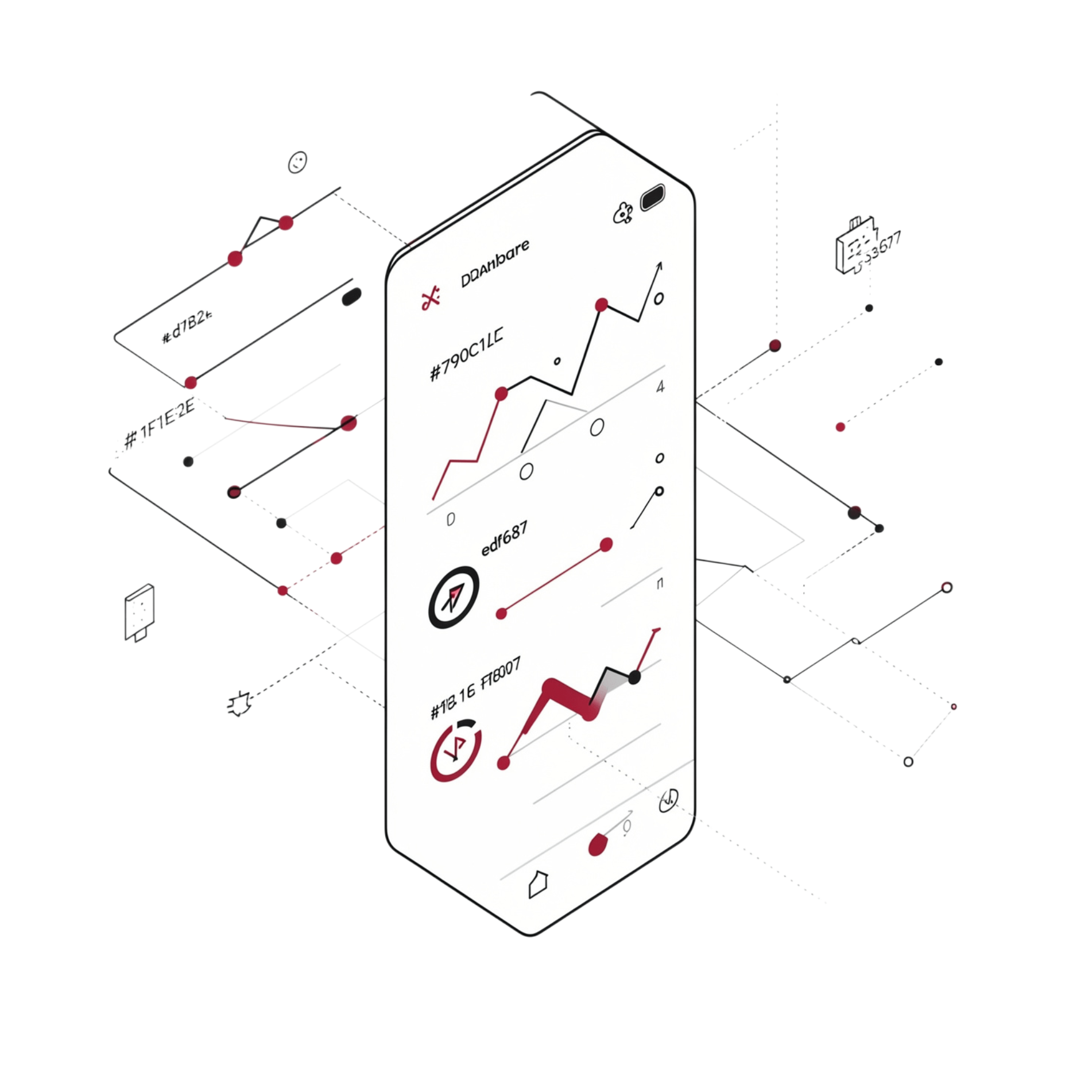
Dashboard and Analytics
What the Dashboard Provides
The centralized dashboard gives users complete visibility and control over their lighting system:
Current room occupancy status
Lighting status for individual rooms
Lighting schedules and timers
Energy consumption information
Device activity logs
Lighting usage analytics
Energy usage reports
Remote control options
These analytics help users understand and optimize electricity consumption across their entire home.

Slide 8
Benefits and Energy Management
Reduces Energy Waste
Lowers Electricity Costs
Enhanced Convenience
Eliminates unnecessary lighting usage and minimizes electricity wastage through automatic control.
Improved energy efficiency directly translates to reduced electricity bills for homeowners.
Provides convenient automatic lighting control and enables remote monitoring and management from anywhere.
Sustainable Living
Better Smart-Home Experience
Encourages sustainable energy usage and supports intelligent energy management for a greener lifestyle.
Improves the overall smart-home experience through seamless, intelligent automation.

Slide 9
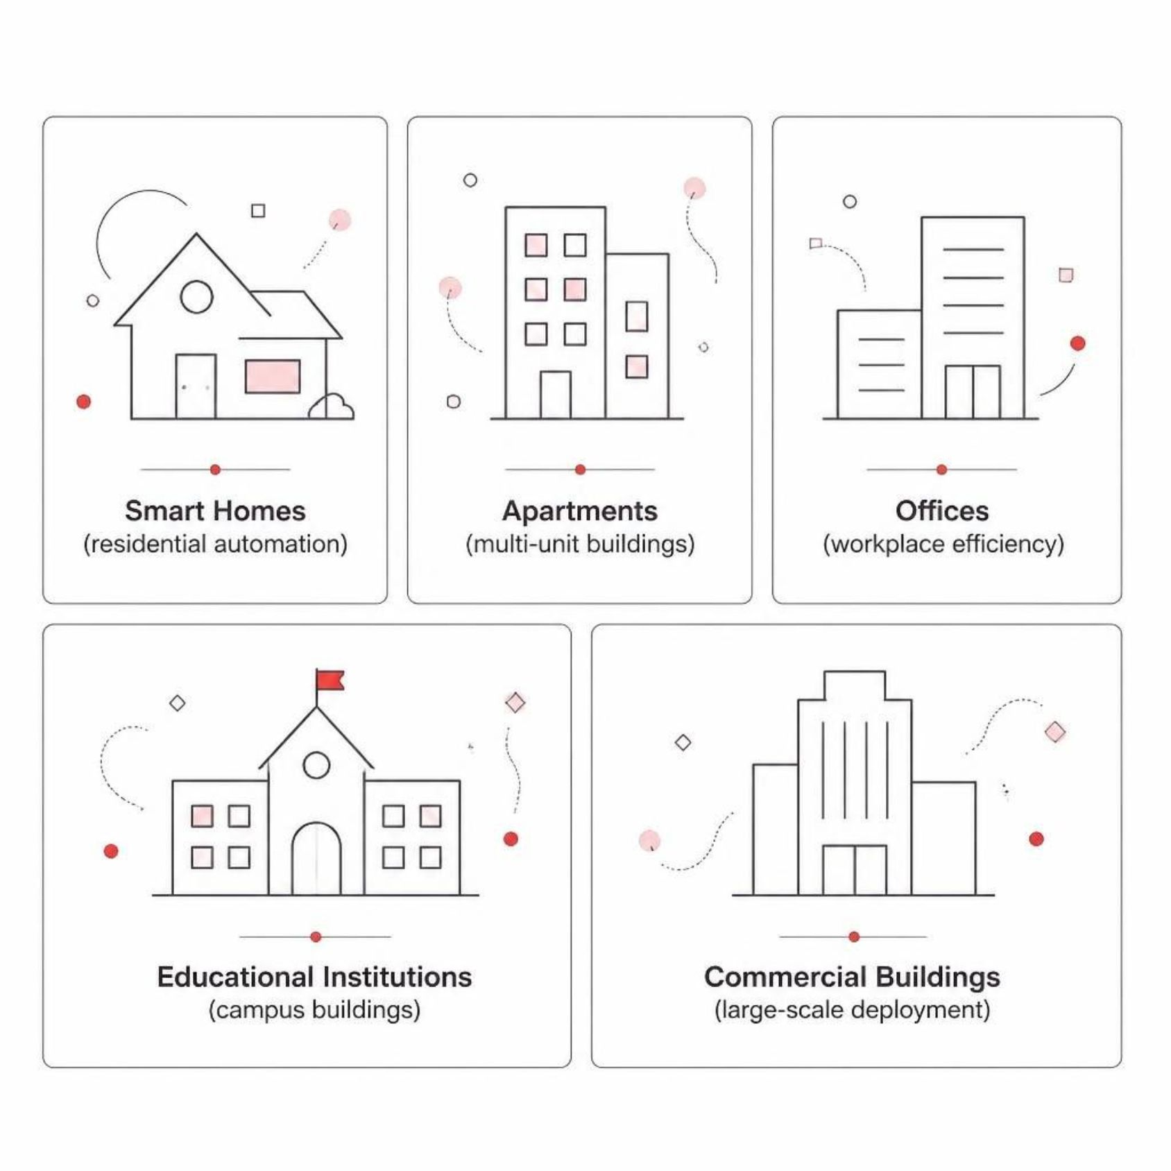
Applications and Scalability
Application Areas
Scalability by Design
The system architecture is built to grow with the user's needs. Whether deployed in a single room or across an entire building, the platform maintains centralized monitoring and control without loss of performance.
Supports multiple rooms, sensors, and lighting devices simultaneously
Centralized dashboard scales to manage any number of connected nodes
Wireless communication removes physical infrastructure constraints
Suitable for residential, institutional, and commercial environments

Slide 10
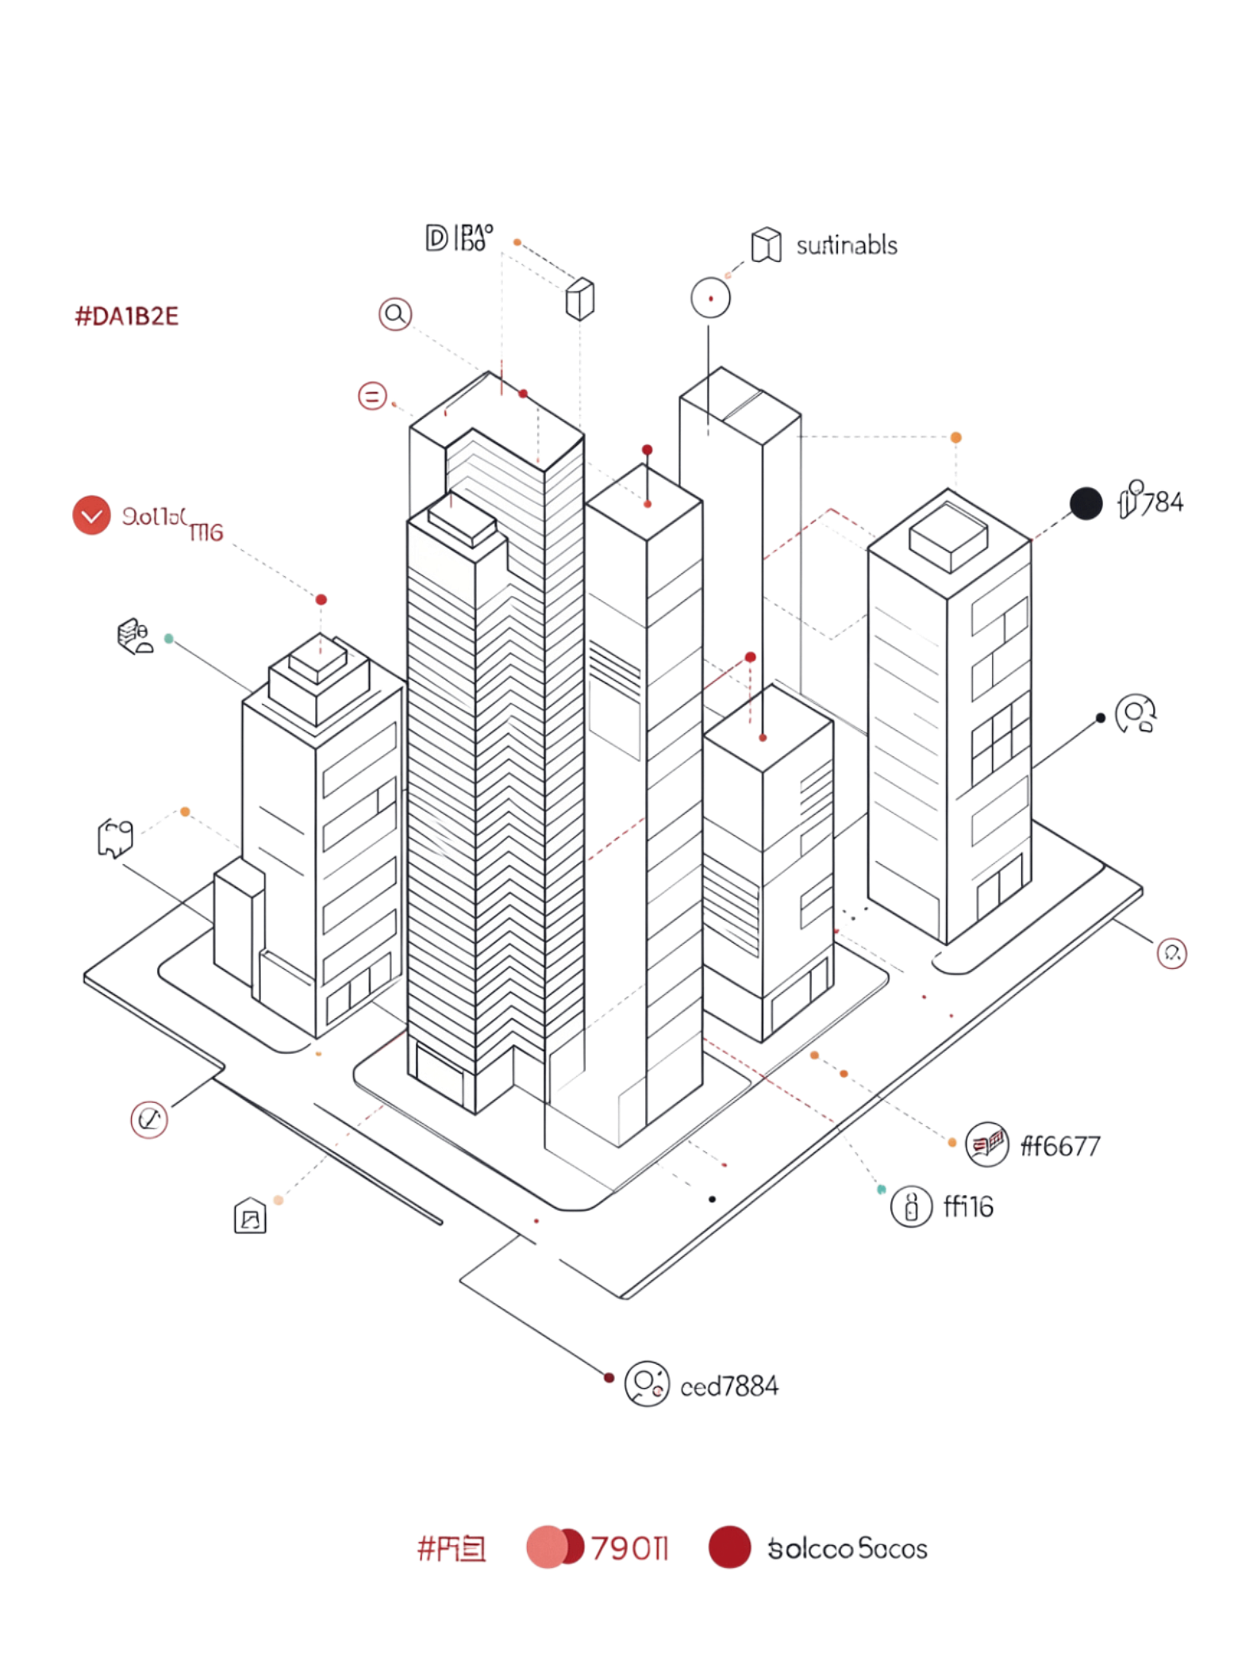
Conclusion and Future Scope
1
Intelligent Automation
The system provides intelligent automatic lighting control based on real-time occupancy, powered by IoT sensors and wireless communication.
2
Energy Efficiency
Energy monitoring and analytics help reduce unnecessary electricity consumption, promoting sustainable and cost-effective smart living.
3
User Convenience
Remote control and a centralized dashboard improve user convenience while keeping the system secure and scalable across different environments.
Overall Objective: To improve energy efficiency, reduce electricity wastage, enhance user convenience, and support sustainable smart living through intelligent lighting automation.

